Slide 1
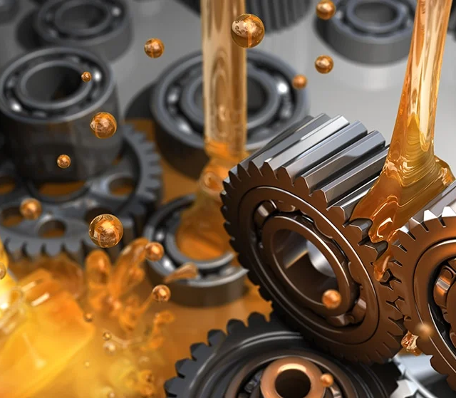

TOPIC- MECHANISM OF DIFFERENT TYPES OF LUBRICANTS
NAME- SHASHWAT SAROJ
SECTION-C
ENROLLMENT NO.-21UEE043
REGISTRATION NO.-2113530

Slide 2
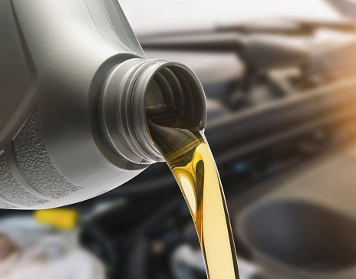
Lubricant: A lubricant is defined as a substance introduced between two moving or sliding surfaces to reduces the frictional resistance between them.
Mechanism of lubricants: There are mainly three types of mechanisms by which lubrication takes place. They are:
(i) Fluid film or thick film or hydrodynamic lubrication
(ii) Boundary lubrication or thin film lubrication
(iii) Extreme pressure lubrication

Slide 3
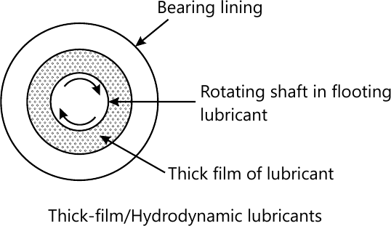
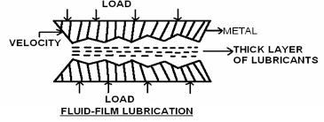
Fluid film or thick film or hydrodynamic lubrication:
Hydrodynamic lubrication: means that the load carrying surfaces of the bearingare separated by a relatively thick film of the lubricant, so as to prevent metal are separated by a relatively thick film of the lubricant, so as to prevent metal to metal contact, and that the stability thus obtained can be explained by the laws of fluid mechanics . Hydrodynamic lubrication also called full film or fluid lubrication. In such system friction depends on viscosity, thickness of lubricant, the relative velocity and area of the moving surfaces. Examples: Delicate instruments, light machines like watches, clocks, guns, sewing machines etc are provided with fluid film lubrication

Slide 4
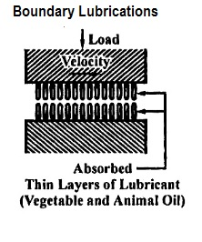
Boundary lubrication or thin-film lubrication
Long hydrocarbon chains which increases the lateral attraction between the chains (larger the hydrocarbon chain greater the van der Waals forces of attraction). (ii) Polar groups to promote wetting or spreading over the surface, lateral attraction between the chains (iii) Active functional groups which can form chemical bonds with metals or other surfaces, (v) High viscosity index (vi) Good oiliness or the capacity to stick to metal surface should be good (vii) resistance to heat and oxidation and (viii) low pour point. Solid lubricants, greases and oils with proper additives function as lubricants in this type of lubrication.Graphite and MoS2, vegetable and animal oils and their soaps are used for boundary lubrication. These materials form films on the metal surfaces having internal friction. So they can bear compression and high temperatures.

Slide 5
Extreme pressure lubrication
When the moving or sliding surfaces are subjected to very high pressure and speed, heat is generated causing the following harmful effect
(i) Local high temperature develops resulting in the formation of a welded junction and metal tearing
(ii) The lubricants fail to stick to the metal surface as result there is vaporization or decomposition of lubricating oil may occurs
(iii) Surface deformation and seizure takes place.

Slide 6

These problems are minimized by adding special additives to mineral oils. These additives form durable films on metal surfaces which can withstand high loads and high temperatures. Important additives are organic esters as chlorinated esters, sulphur as in sulphurised oils or phosphorous as in tricresyl phosphate. These compounds react with metallic surfaces at high temperatures and form metallic chlorides, sulphides or phosphides. These metallic compounds possess high melting points and serve as good lubricants at high temperatures and high pressures

Slide 7
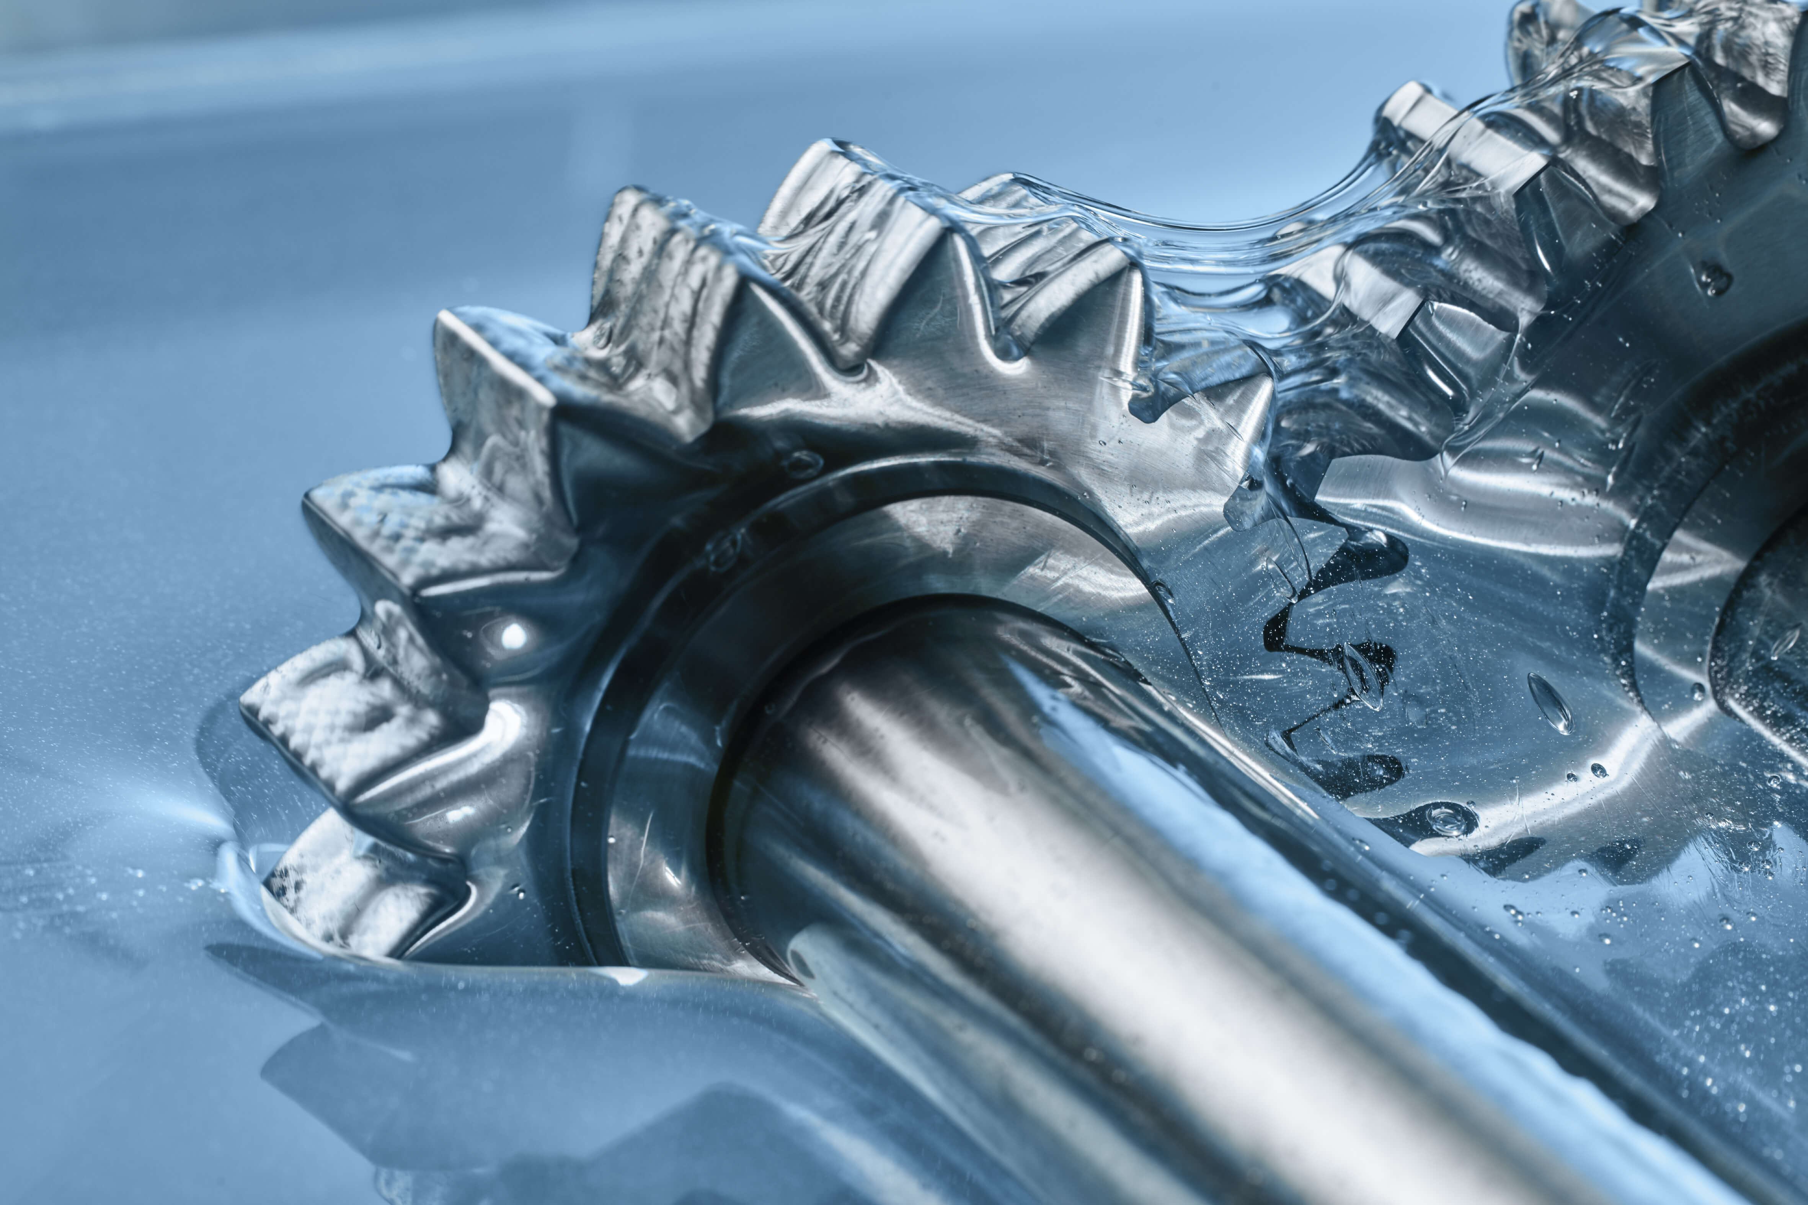
It is important that under extreme pressure condition the lubricant is not just a film or coating over the metal surface, it is a permanent modification of the metal surface. The surface compound is a few molecular layers thick. The coefficient of friction is 0.1 to 0.4 cm/s. The film is remain intact under high pressure and temperature and lubricate the surface. If by chance the film breaks due to the rubbing action of the moving parts, it is immediately replenished. Extreme pressure lubricants find in use in aircrafts and spacecrafts.

Slide 8
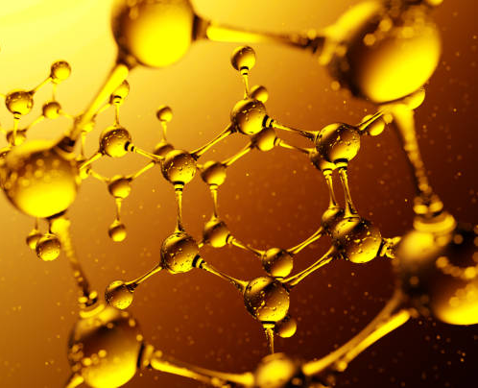
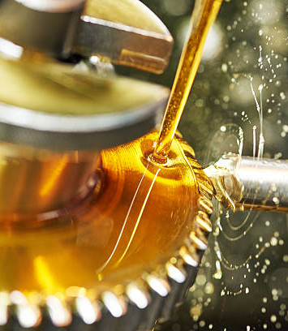
THANK YOU

